Slide 1



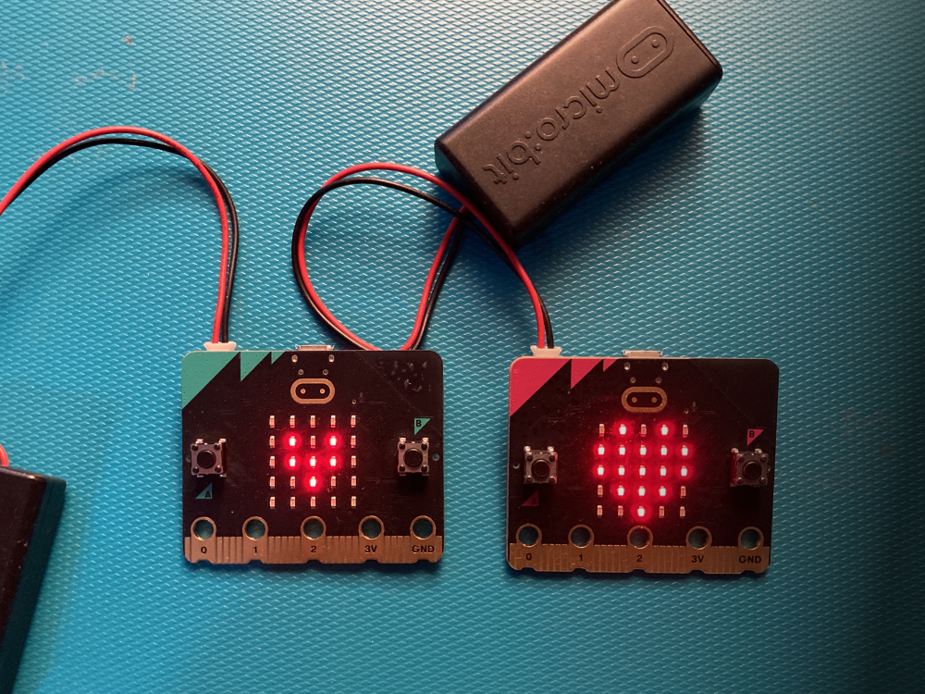


Lesson 2 Beating heart

Slide 2
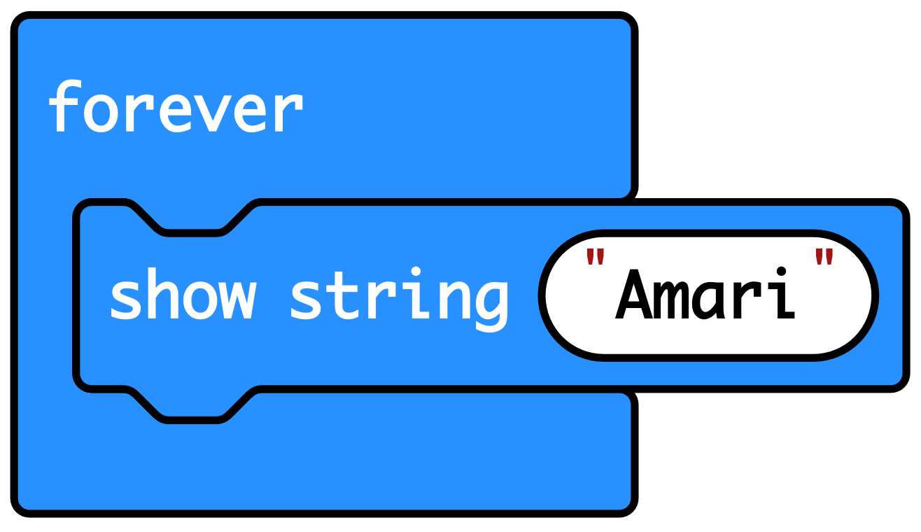
Recap: what did we discover about the micro:bit?
It’s a tiny computer.
You tell it what to do by creating code which you send to the micro:bit.
The code is an algorithm, a sequence of instructions.
The micro:bit has an LED display which it uses as an output to send out information such as our names.
The ‘forever’ loop kept the code running.

Slide 3





Think: learning objectives
I can create a micro:bit animation using a sequence of images in a loop.
I can explain that the order or sequence of instructions is important.
I can explain that loops can make code more compact and easier to read.
Notes:
Explain: animation is a sequence of still images shown one after the other to look like movement. Loops allow us to repeat sets of instructions without having to write them out multiple times. We used sequences of instructions in a loop last time to keep showing our names and pictures on the micro:bit’s display. Ask students: where else you have seen animations? E.g. cartoons, games.

Slide 4
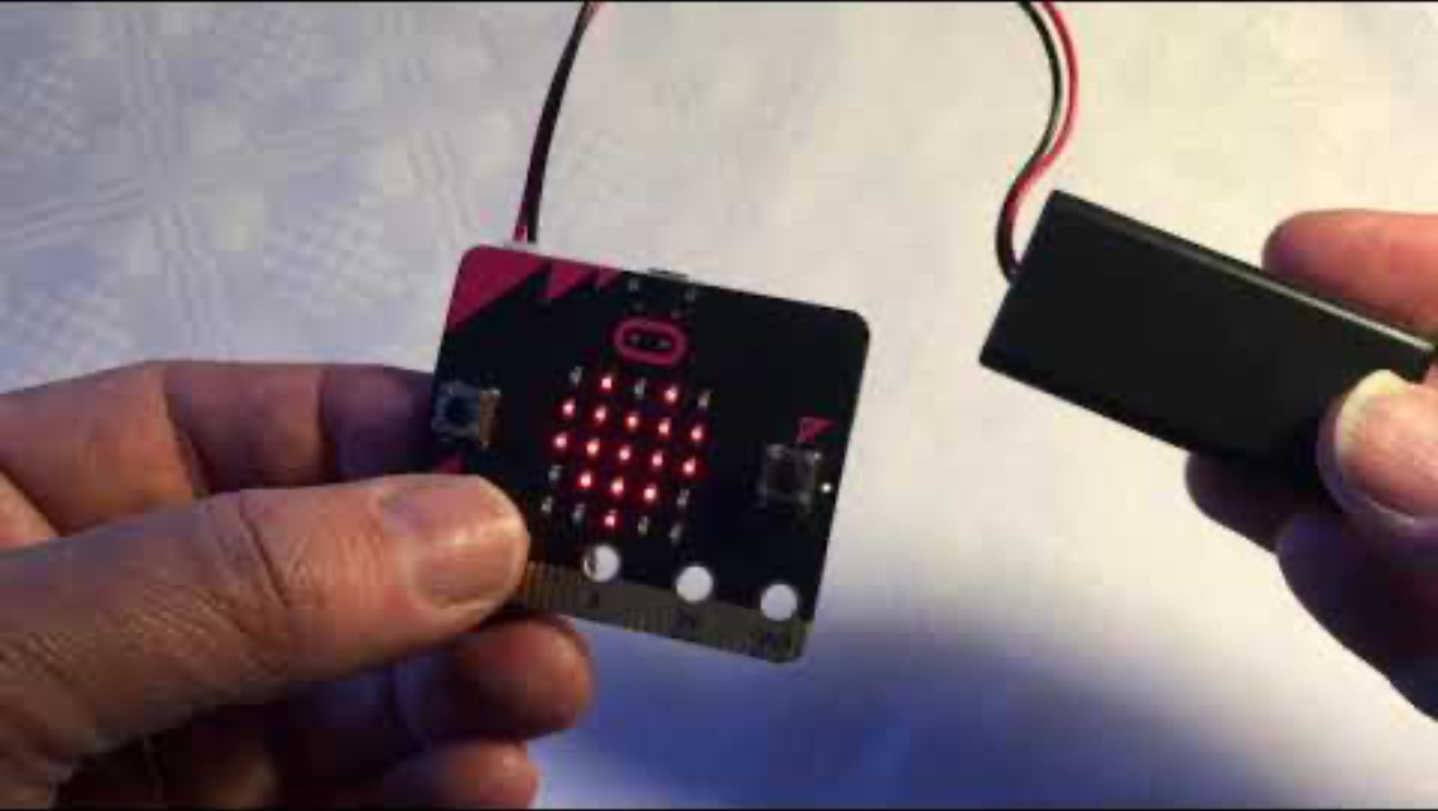



Think: beating heart introduction video
Optionally play video: https://youtu.be/8qzYWH10o6E

Slide 5


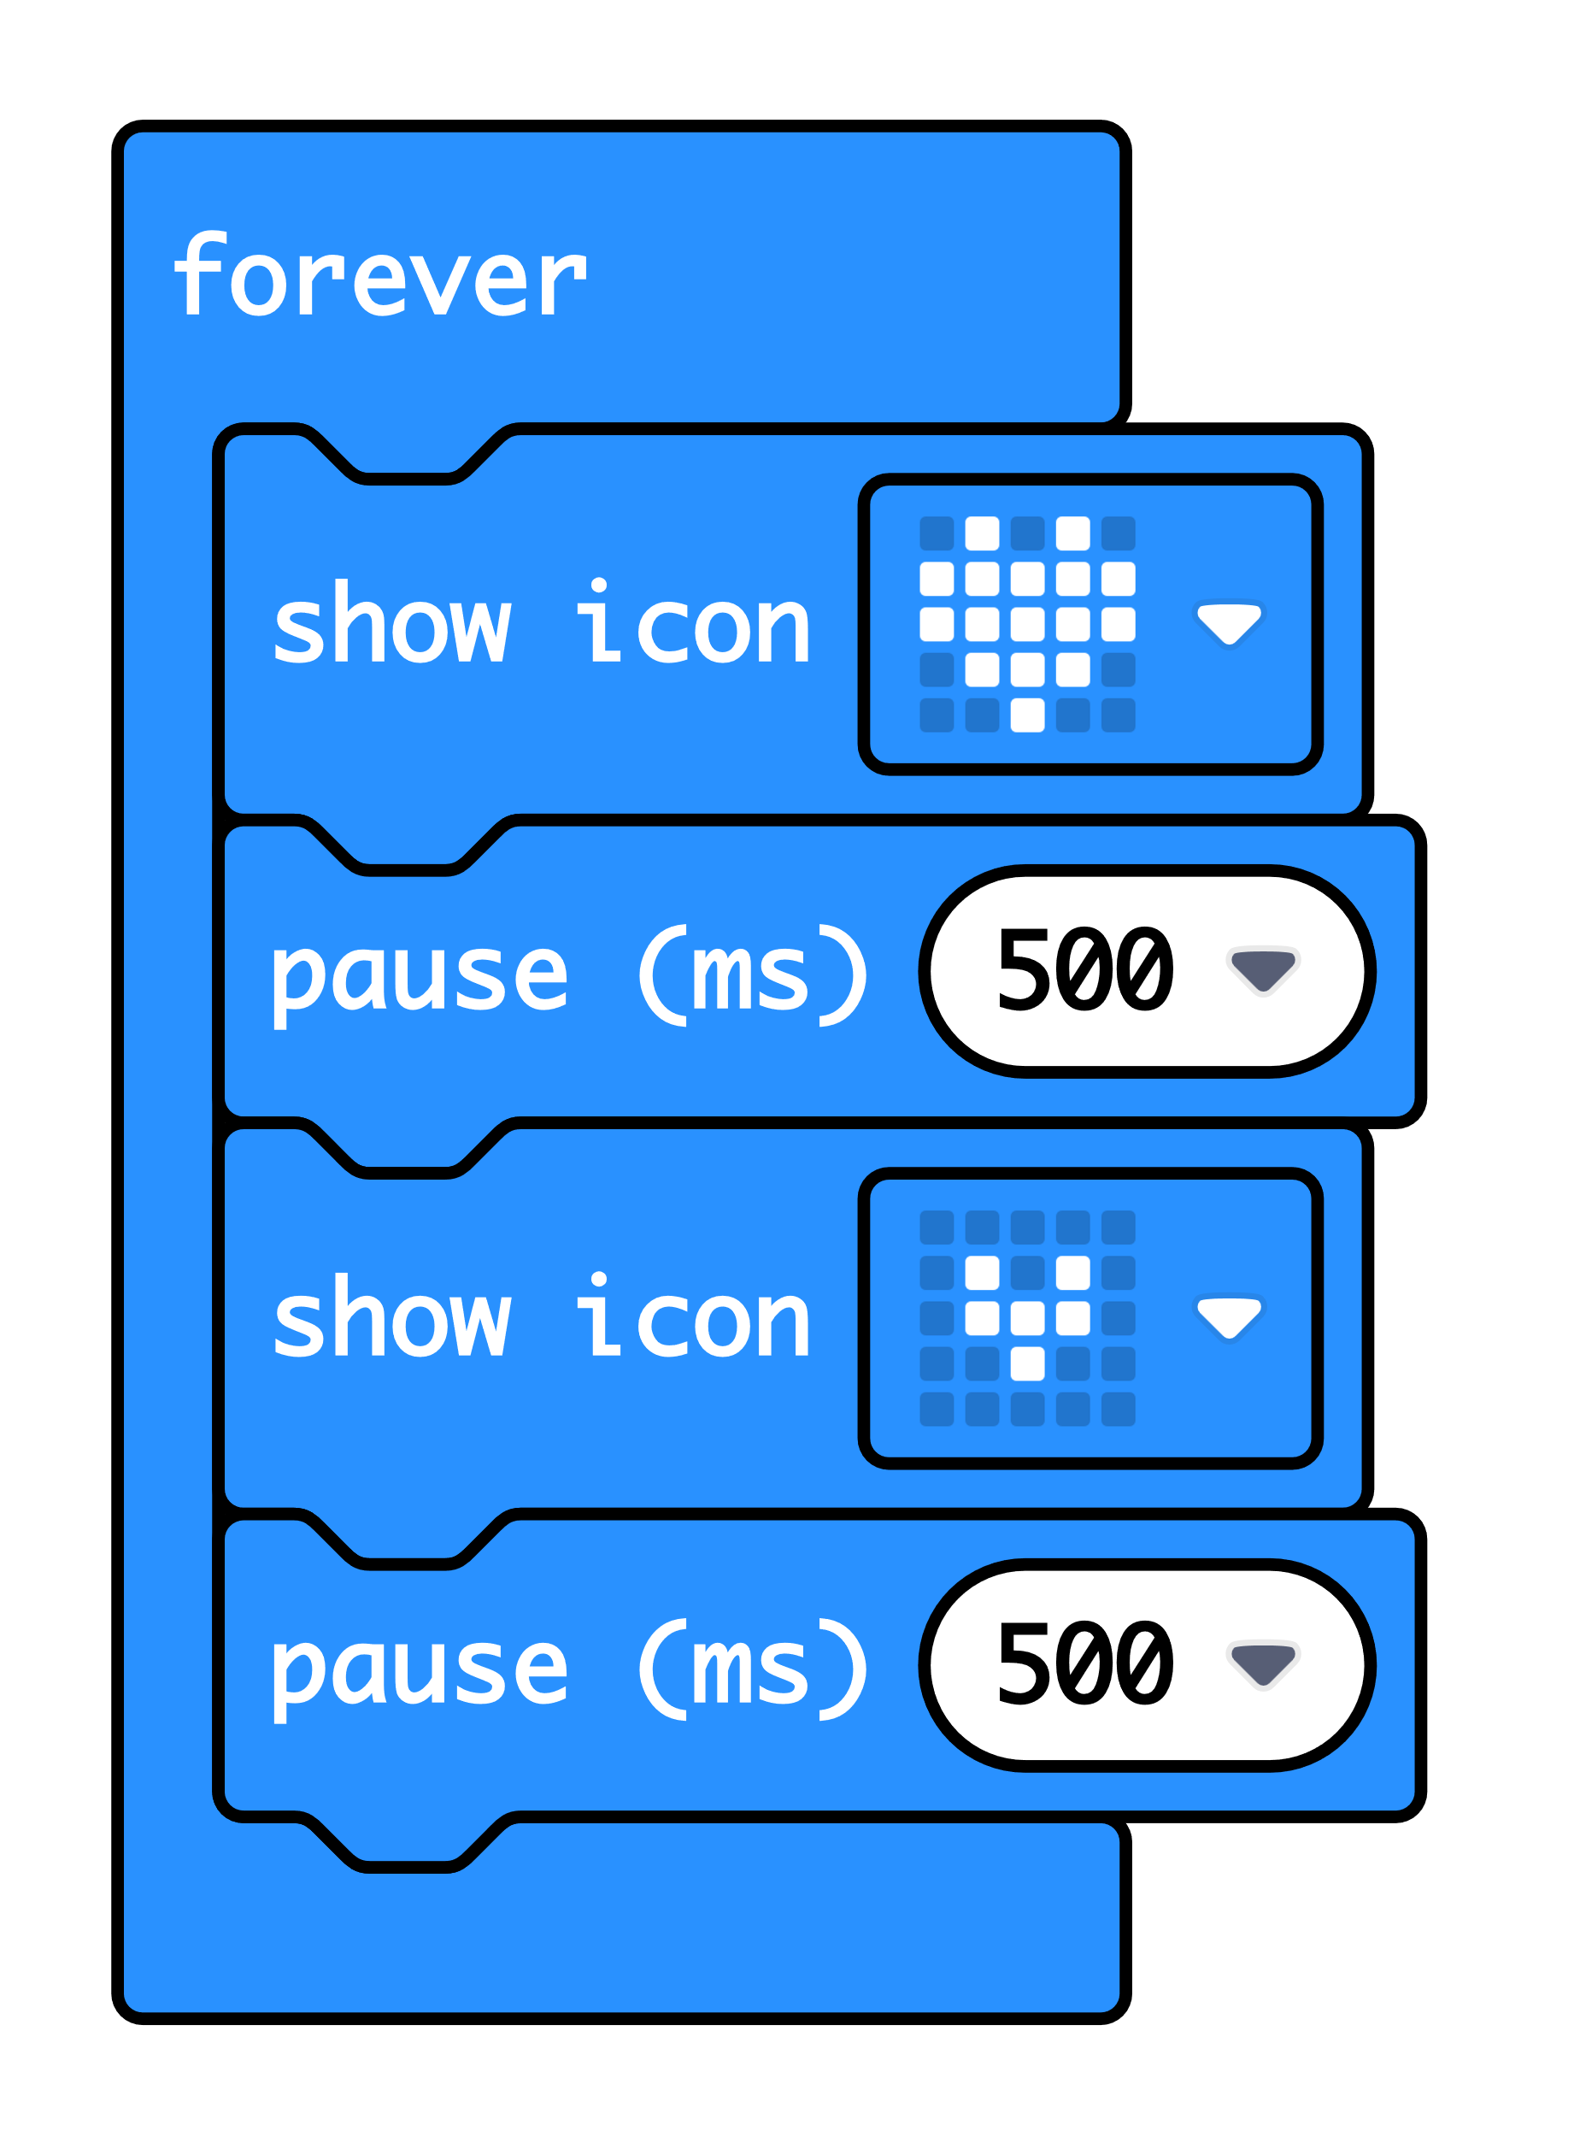

Create: examine the code
‘Forever’ is a loop that keeps the code running.
‘Show icon’ lights up the LED display output in a pattern.
‘Pause’ makes the micro:bit wait before carrying out the next instruction. 500 milliseconds is half a second.
After carrying out these four instructions, the loop goes back to the top and starts again.
Teacher: open completed code in editor
Notes:
The ‘forever’ block is a loop which keeps the sequence going. It’s an ‘infinite loop’ – a loop that keeps going as long as the micro:bit has power.
The ‘show icon’ and ‘pause’ blocks make up the sequence. Changing the pause time makes the animation faster or slower.
At the end of the sequence, the loop goes back to the top and starts again. Using a loop means we can use only 4 blocks to create an animation that runs forever.
You can follow the link to open the completed code in the editor. You can model changing the pause times and seeing what effect that has in the simulator.

Slide 6

Create: build the code
Open a new MakeCode project https://makecode.microbit.org/
Notes:
You can follow the link to open a new MakeCode project and model building the code yourself – or use slide 7 to show a YouTube coding video, or slide 8 to show an animated GIF of building the code if YouTube is blocked in your school.

Slide 7

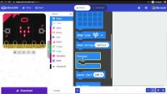
Create: coding video
YouTube coding video: https://mbit.io/lessons-heart-code-video
Notes:
Optionally share this YouTube coding video with your class: https://mbit.io/lessons-heart-code-video

Slide 8


Create: coding animation
Notes:
Animated GIF of building the code you can share with your students, if YouTube is blocked in your school.

Slide 9
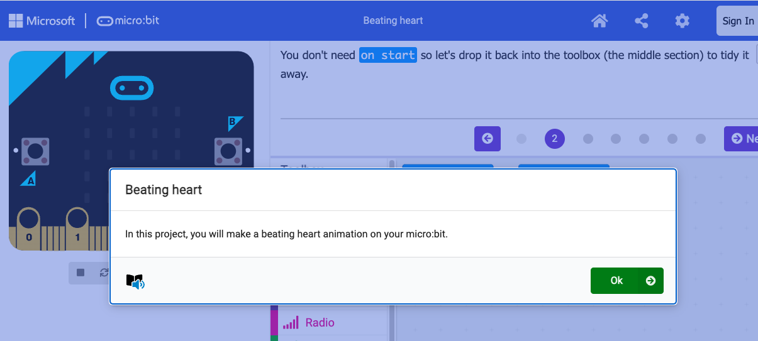
Create: step-by-step online tutorial
https://mbit.io/tutorial-beating-heart
Notes:
You can optionally share this online step-by-step tutorial with your students to follow individually.

Slide 10


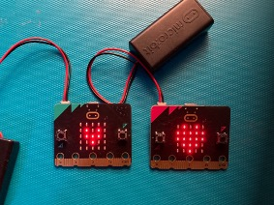

Evaluate
Download your code to a micro:bit
Does it work as you expect?
How good is the project?
Could it have other uses?
How does it work?
Notes:
Students transfer code to their micro:bit and test.
If you have a battery packs, encourage students to unplug micro:bits from computers and attach batteries. Their code remains on the micro:bit and will still work
Does it work as you expect?
If not, do you need to debug the code and download it again?
How good is the project?
Can you think of anyone who would like this project and find it useful of enjoyable?
How could you improve it?
Could it have other uses?
How does it work?
Encourage students to think about how it works when holding it in their hands.

Slide 11

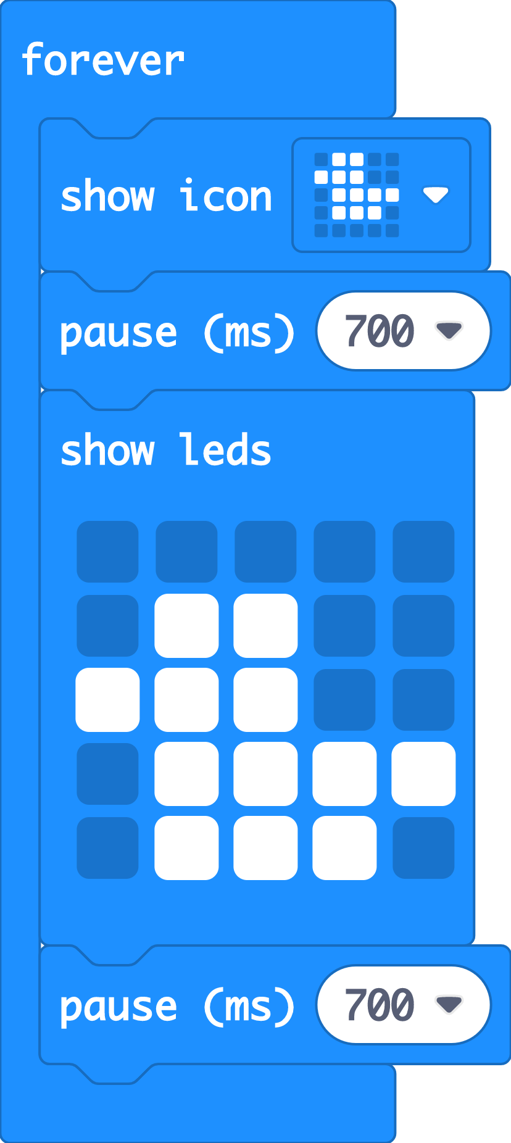

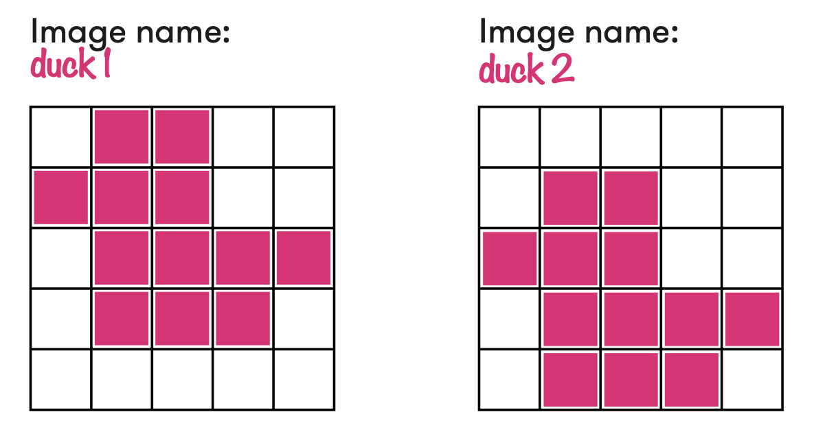

Extend
Change the pause times – what effects do shorter and longer pause times have on the animation?
Create your own animations using the ‘show LEDs’ block.
Make longer sequences with more images.

Slide 12

Share: revisit the learning objectives
I can create a micro:bit animation using a sequence of images in a loop.
I can explain that the order or sequence of instructions is important.
I can explain that loops can make code more compact, and easier to read.
Notes:
Ask students:
Did your sequence of pictures and pauses make an image appear to move? (The pictures have to be in the right order with pauses of the right length to make it appear to move. If the pauses are too short, you won’t see the images. If they are too long, the illusion of movement is broken.)
How does a loop help? (The loop keeps the animation sequence running forever, but without adding any extra code blocks.)

Slide 13

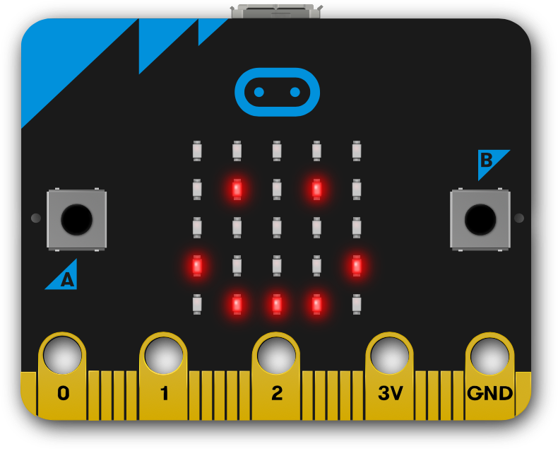

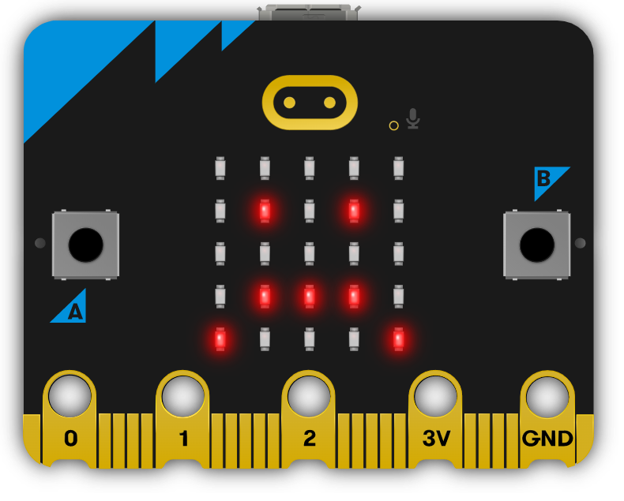
Next steps
Today we used the ‘forever’ loop block and sequences of instructions to make animations on the micro:bit’s LED display output.
Next time, we’ll use some of the micro:bit’s inputs, to make different pictures appear when we press different buttons.

